Slide 1
House Price Predictions
EDA

Slide 2
Problem Statement
Conducting Over all Data Analysis on the given data set and finding Features/Parameters which are highly affecting the selling price of the house.
Building a model to predict the selling price of a house on the given parameters and determine which model works best, the top 15 features which are being used by the model in predicting the selling price.
These Predictions made will be help full in setting up an ideal price considering all the factors.

Slide 3
Dataset Overview
There are 81 Columns, following are the datatypes: float64(3), int64(35), object(43)
The data is from Year 1875 - 2010
There are 17 columns with null values in the dataset
Outliers are present in the dataset as they add value to the model they will not be removed

Slide 4
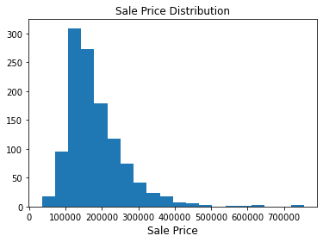
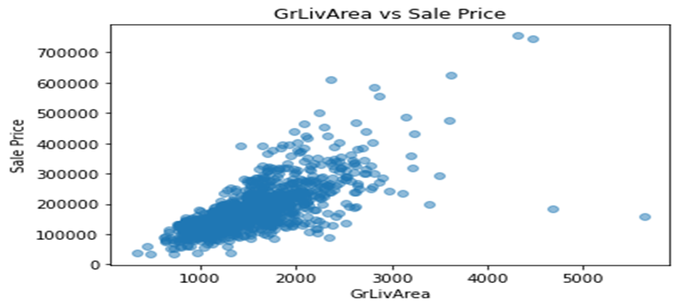
Distribution of the data
From the Graph we can observe that most of the houses are prices between 10,000$ - 25,000$
There are few outliers in the data but in the interest of having diversity rows have not been dropped.
From the Scatterplot we can observe that the majority of the Dataset Contains Live Area from – 800Sq Ft – 2500Sq Ft
Houses with Live Area greater than 3000Sq Ft are mostly priced above 20,000$

Slide 5
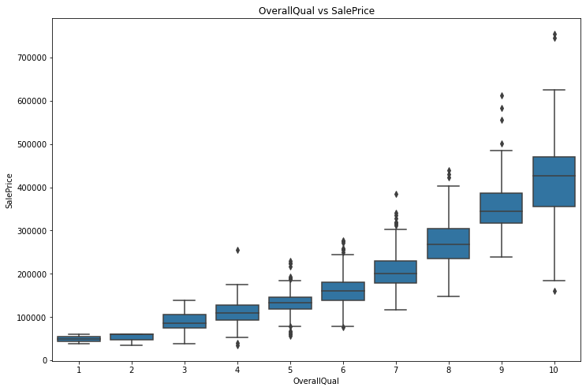
Overall Quality to the Sale price of the house
From this we can observe that as the Quality rating increases the house price is also have a positive effect where the average price of house’s rated 10 is above 40,000$.
Houses Rated 1-2 with OverallQual as priced less than 10,000$.

Slide 6
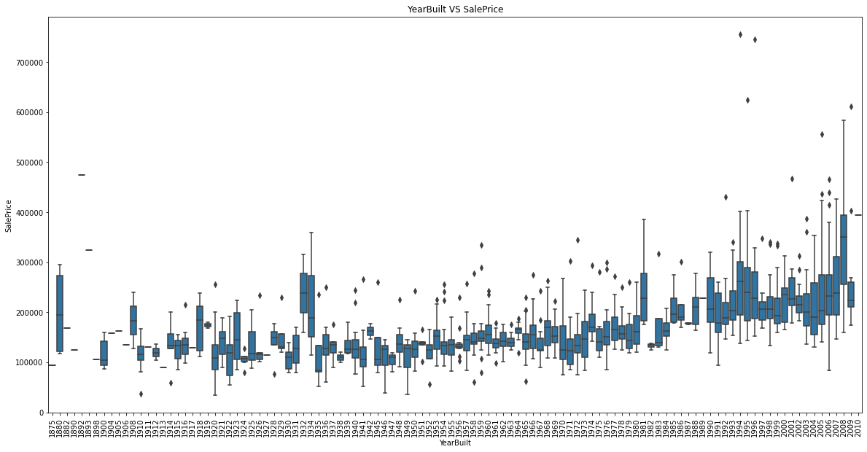
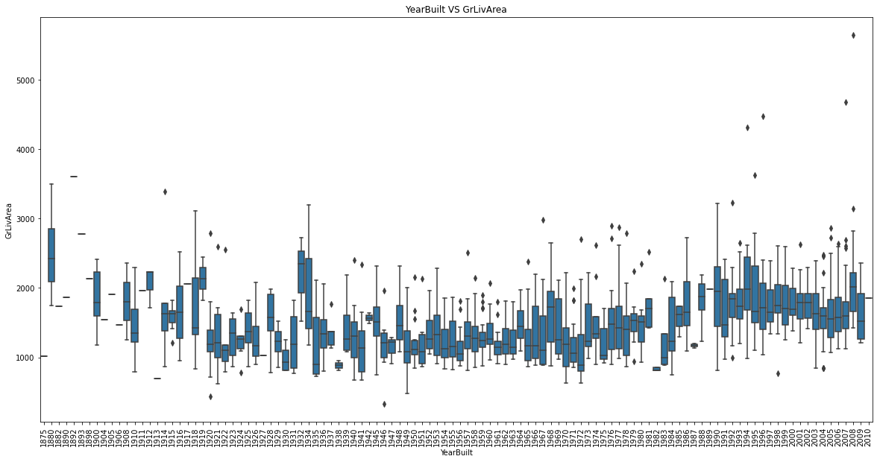
Year Built to the Sale Price of the house to LiveArea
Observations made from comparing both the Graphs
Older Houses are mostly under 20,000$ with few exceptions – which can be because of the Live area which we can observe comparing both Graphs.
We can say that the Year of Building the house is positively affecting the price of the house even without gear difference in live area.

Slide 7
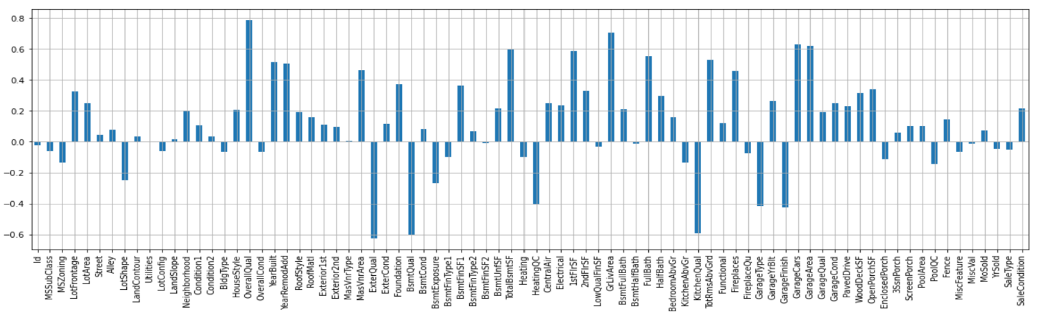
Correlation of attributes to target variable
Positive Correlation
Negative Correlation
Features | Correlation
OverallQual | 0.789185
GrLivArea | 0.707300
GarageCars | 0.628329
GarageArea | 0.619000
TotalBsmtSF | 0.595042
1stFlrSF | 0.587642
FullBath | 0.554988
YearBuilt | 0.514408
Features | Correlation
HeatingQC | -0.406604
GarageType | -0.415370
GarageFinish | -0.424922
KitchenQual | -0.592468
BsmtQual | -0.601307
ExterQual | -0.624820

Slide 8
Data Cleaning and Encoding
Discreet Categorical Columns Encoding
We Have considered following Columns as Discreet Categorical values and used Onehot Encoding using get_dummies() Method to them
['MSZoning','Street','Alley','Utilities','LotConfig','Neighborhood','Condition1','Condition2','BldgType','HouseStyle','RoofStyle','RoofMatl','Exterior1st','Exterior2nd','MasVnrType','Foundation','Heating','CentralAir','GarageType','MiscFeature','SaleType','SaleCondition']
Ordinal Categorical Columns Encoding
We have Encoded Following columns using ordinal encoding and modified them to int values
['LotShape','LandContour','LandSlope','ExterQual','ExterCond','BsmtQual','BsmtCond','BsmtExposure','BsmtFinType1','BsmtFinType2','HeatingQC','Electrical','KitchenQual','Functional','FireplaceQu','GarageFinish','GarageQual','GarageCond','PavedDrive','PoolQC','Fence']
Final Data used for building model has : 1168 entries, 0 to 1167
Columns: 217 entries, dtypes: float64(24), int64(34), uint8(159)

Slide 9
Model building algorithms used
S.no | Algorithm | Parameters | R2 Score | MAE(Absolute) | MSE(Squared)
1 | GradientBoostRegressor | learning_rate=0.1, n_estimators=1000,max_depth=3, min_samples_split=2, min_samples_leaf=1, max_features='sqrt', random_state=89, criterion= ‘mae' | 92.83 | 15372.12 | 534544208.02
2 | XGBRegressor | objective = 'reg:squarederror',colsample_bytree =0.7, learning_rate=0.1, max_depth = 3, min_child_weight = 1, n_estimators = 500, subsample = 0.5 | 91.84 | 15388.12 | 609304374.75
3 | RandomForestRegressor | criterion= 'mse', max_depth = 10, n_estimators= 10 | 89.60 | 19313.62 | 775762889.76
4 | Lasso Regressor | alpha= 5.0 | 89.8 | 19682.35 | 760473931.95
5 | Linear Regressor | random_state=89 | 89.57 | 19896.38 | 777392877.26
Metricises Used
R2 Score- “Total variance explained by model/ Total variance”. So, if it is 100%, the two variables are perfectly correlated, i.e., with no variance at all. A low value would show a low level of correlation, meaning a regression model that is not valid.
MAE – Mean Absolute error is the average of the errors. The larger the number greater the error.
MSE - Mean square error is the average of the square of the errors. The larger the number the larger the error.

Slide 10
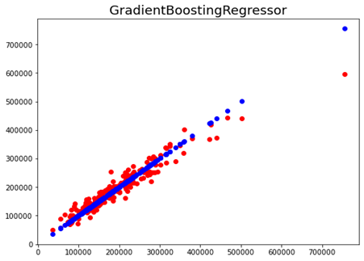
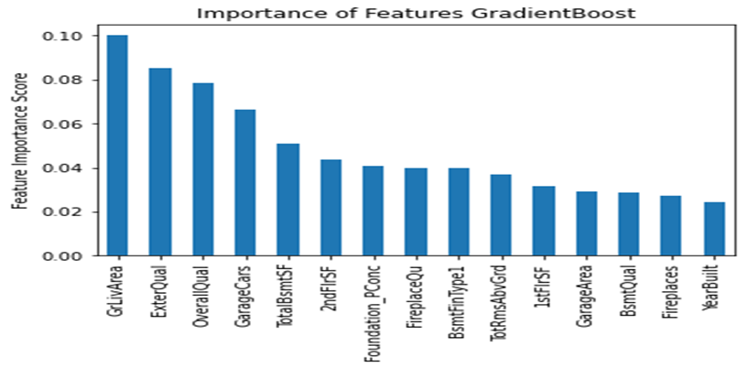
Final Model Scores Using Gradient BoostRegressor
S.no | Algorithm | Parameters | R2 Score | MAE(Absolute) | MSE(Squared)
1 | GradientBoostRegressor | learning_rate=0.1, n_estimators=1000,max_depth=3, min_samples_split=2, min_samples_leaf=1, max_features='sqrt', random_state=89 | 92.83 | 15372.12 | 534544208.02

Slide 11
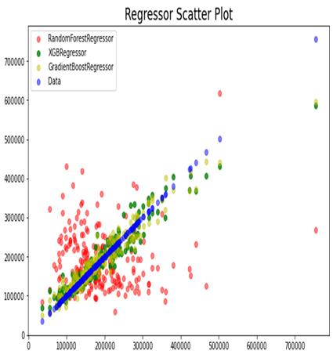
Comparing the models scatter plot

Slide 12
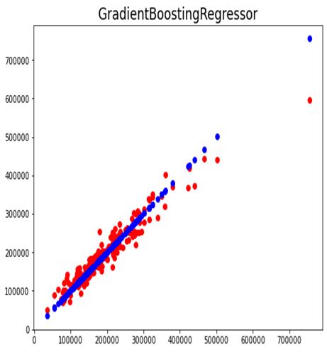
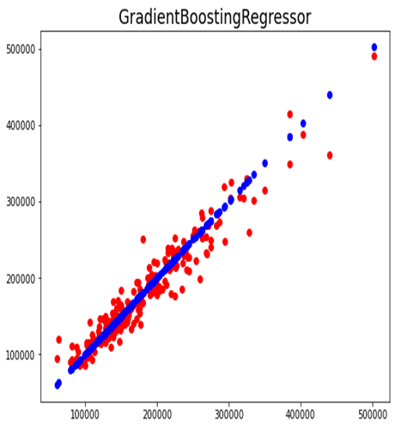
Model Performance before and after removal of outliers
S.no | Algorithm | R2 Score | MAE(Absolute) | MSE(Squared)
With outliers | GradientBoostRegressor | 92.84 | 15372.12 | 534544208.02
With the outliers removed | GradientBoostRegressor | 92.62 | 13632.91 | 351362319.88
Before Outlier removal
After Outlier Removal

